Slide 1

Communications Survey
Summary of findings and where do we go from here

Slide 2
How CERT Teams Notify (Callout)

Slide 3
How CERT Teams communicate responding

Slide 4
What Frequency Bands & Technology do you use?
P25 Analog DMR
Can you program your radios?
57% Yes, 28% No, 14% No Answer

Slide 5
Other Radio Communications ?

Slide 6
Other Communications Technology ?

Slide 7
Statewide sampling of Networks
Berkshire County VHF
Franklin County UHF with some VHF
Hampden VHF, some UHF some 800
Worcester Rutland UHF, New Braintree VHF FD, 800 PD
Middlesex UHF, some VHF, some 800
Essex Mix of VHF, UHF
Suffolk Mostly UHF some 800
Norfolk UHF PD/FD VHF DPW etc
Bristol UHF PD/FD VHF DPW etc
Plymouth UHF PD/FD VHF DPW 800
Barnstable VHF Low, VHF, UHF, 800
Nantucket VHF. Dukes VHF
In Counties where there is a mix of VHF/UHF sometimes is is VHF FD and UHF PD. In the West of the State some PDs and FDs maintain VHF low band as a secondary backup

Slide 8
So What is the answer?????
While there are more UHF than VHF Networks in the State, VHF has its place.
UHF penetrates buildings better, VHF covers hilly terrain better than UHF
VHF has a larger coverage area on direct than UHF
CERT Teams have to be able to communicate with their Public Safety Agencies so stay with them
You shouldn’t have to carry multiple radios
We recommend those Towns that are on VHF stay on VHF, those that are on UHF stay on UHF
The answer is INTEROPERABILITY!

Slide 9
Interoperability- The alphabet soup of radio communications
Program is administered by CISA which is part of DHS under its SAFECOM program which also sponsors AUXCOM and SHARES
Publishes NiFOG- National Interoperability Field Operations Guide
NiFOG is a directory of all Federal and State/Local authorized frequencies for use by appropriate entities to insure communications capabilities during incidents.
Some frequencies are reserved for Federal Agencies, Some are reserved for Police and some for Fire
Others are open for Local and State without licensure
You should get permission from MEMA before using a direct channel.
Some repeater channels have to be turned on by MEMA or MSP
Radios purchased with Grant money are required to have Vtac/Utac/8tac in them

Slide 10
Low Band Tac Channels

Slide 11
VHF Direct Channels

Slide 12
VHF Repeater Channels

Slide 13
Utac Channels Direct & Repeater

Slide 14
800Mhz 8Tac or iTac Channels

Slide 15
So you are saying stay where we are???
How do we communicate???
Keep in mind that at a Mutual Aid event, not every team member needs to talk to every other team members.
Team leaders and sector chiefs need to talk to each other and to Command
MEMA has some expensive High Tech technologies that solve this problem such as TAC-STAC and Cross patching that we can’t afford
MEMA also has some Low Tech inexpensive technologies that we can copy and even come up with less expensive versions.
A Portable Cross Band VHF/UHF Repeater using 2- mobile radios and a power supply
A portable Zello Internet Radio Gateway using 1 mobile radio, a PC and a power Supply with Zello Work Networks.

Slide 16
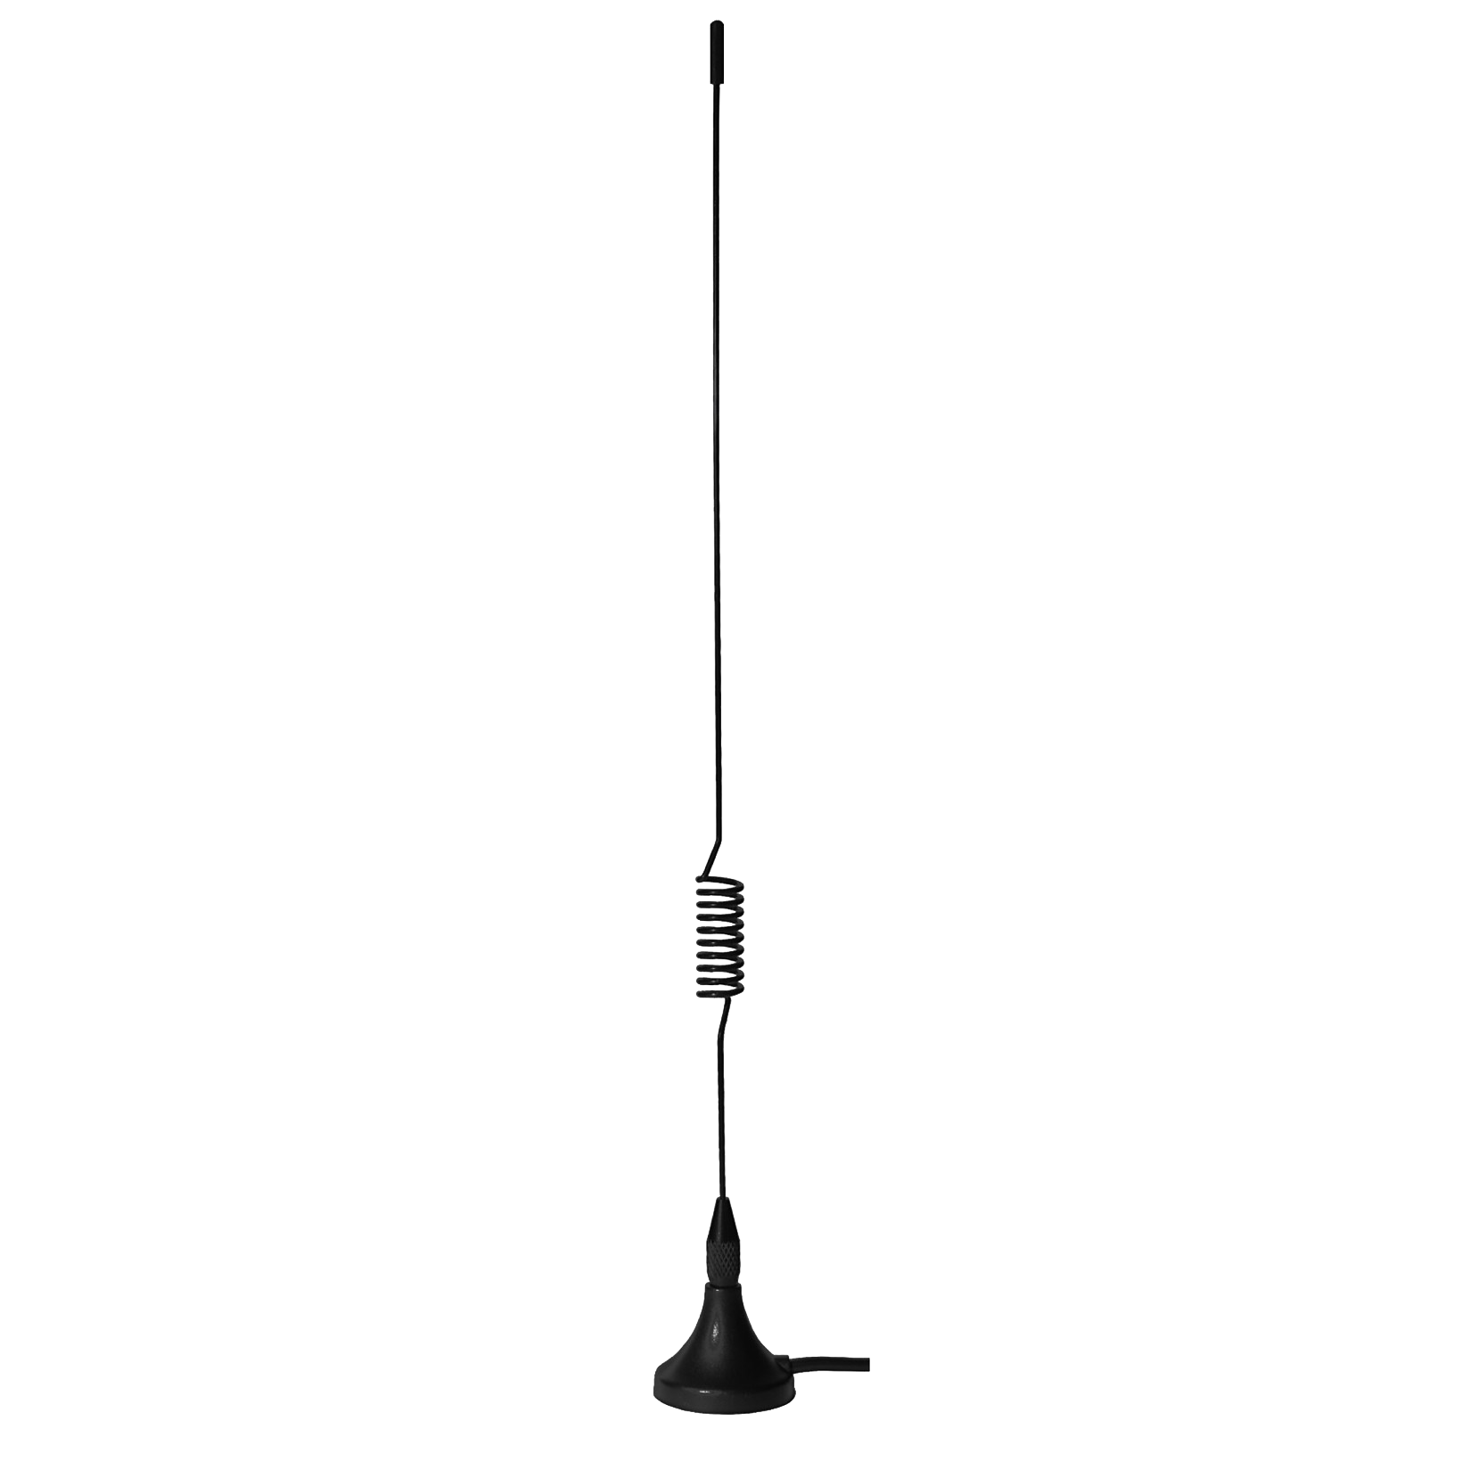
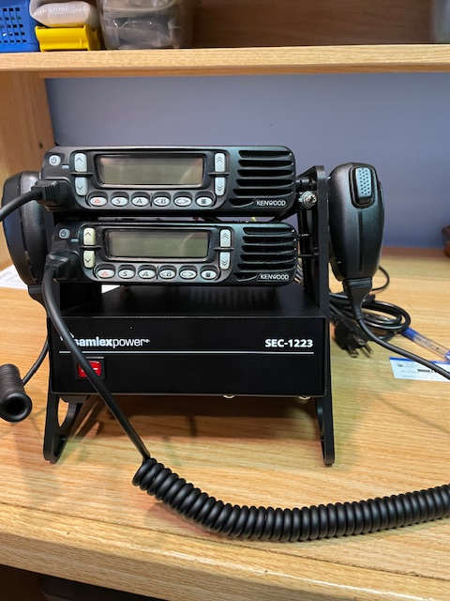
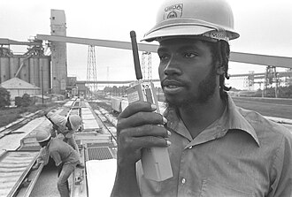
Cross Band Repeater VHF/UHF
This Photo by Unknown Author is licensed under CC BY-SA
This Photo by Unknown Author is licensed under CC BY-SA
CERT
User VHF
CERT
User UHF
This Photo by Unknown Author is licensed under CC BY-NC
This Photo by Unknown Author is licensed under CC BY-NC

Slide 17

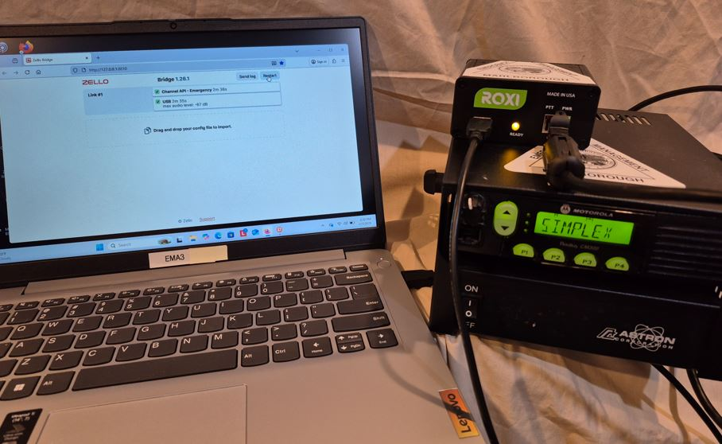
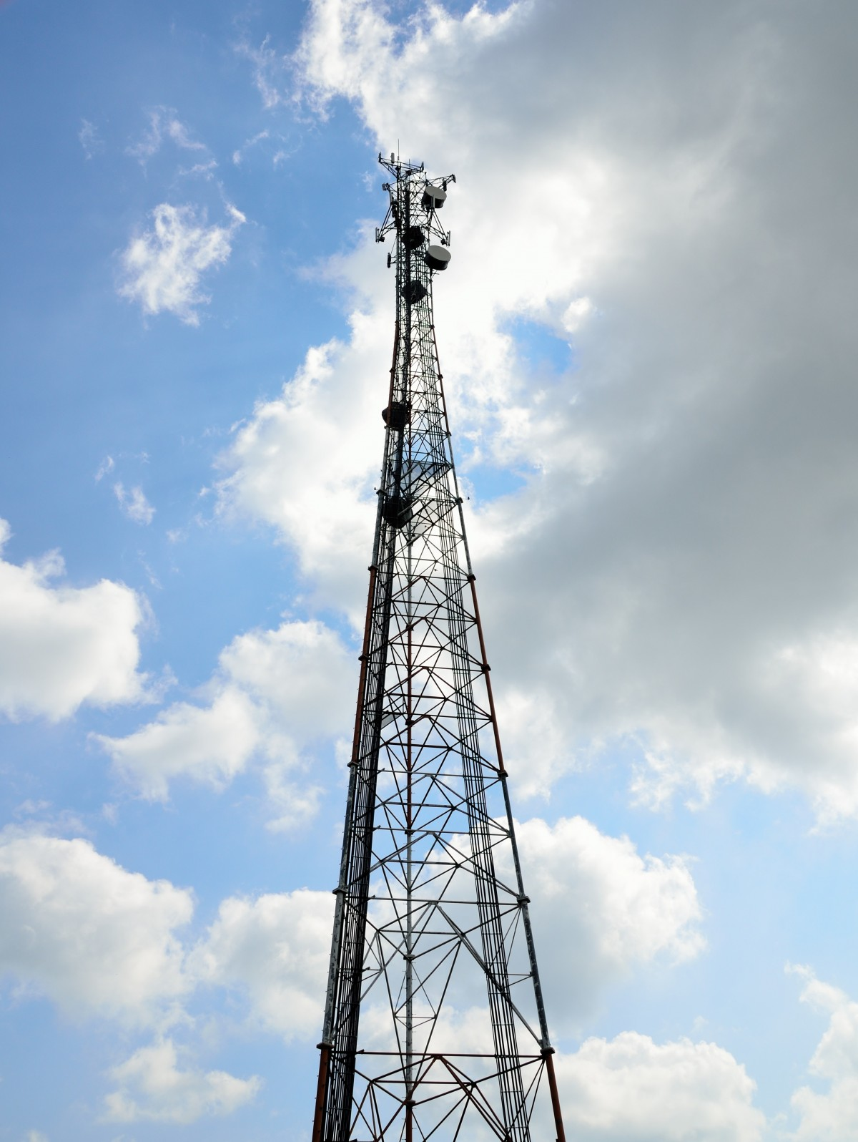

Zello Internet Gateway
Using RoxiBox
Town Repeater
Mini PC
Internet
This Photo by Unknown Author is licensed under CC BY-SA
CERT
Radio User
CERT
Phone User

Slide 18
Zello GateWay Demonstration
Eric Williams Marlborough EMA-CERT
.

Slide 19
Network Configuration
CERT-MA
ZELLO Work
Team Leaders
Each CERT Teams Network
Crosslinked to CERT-MA
Network
Each CERT Teams Network
With Team Members

Slide 20
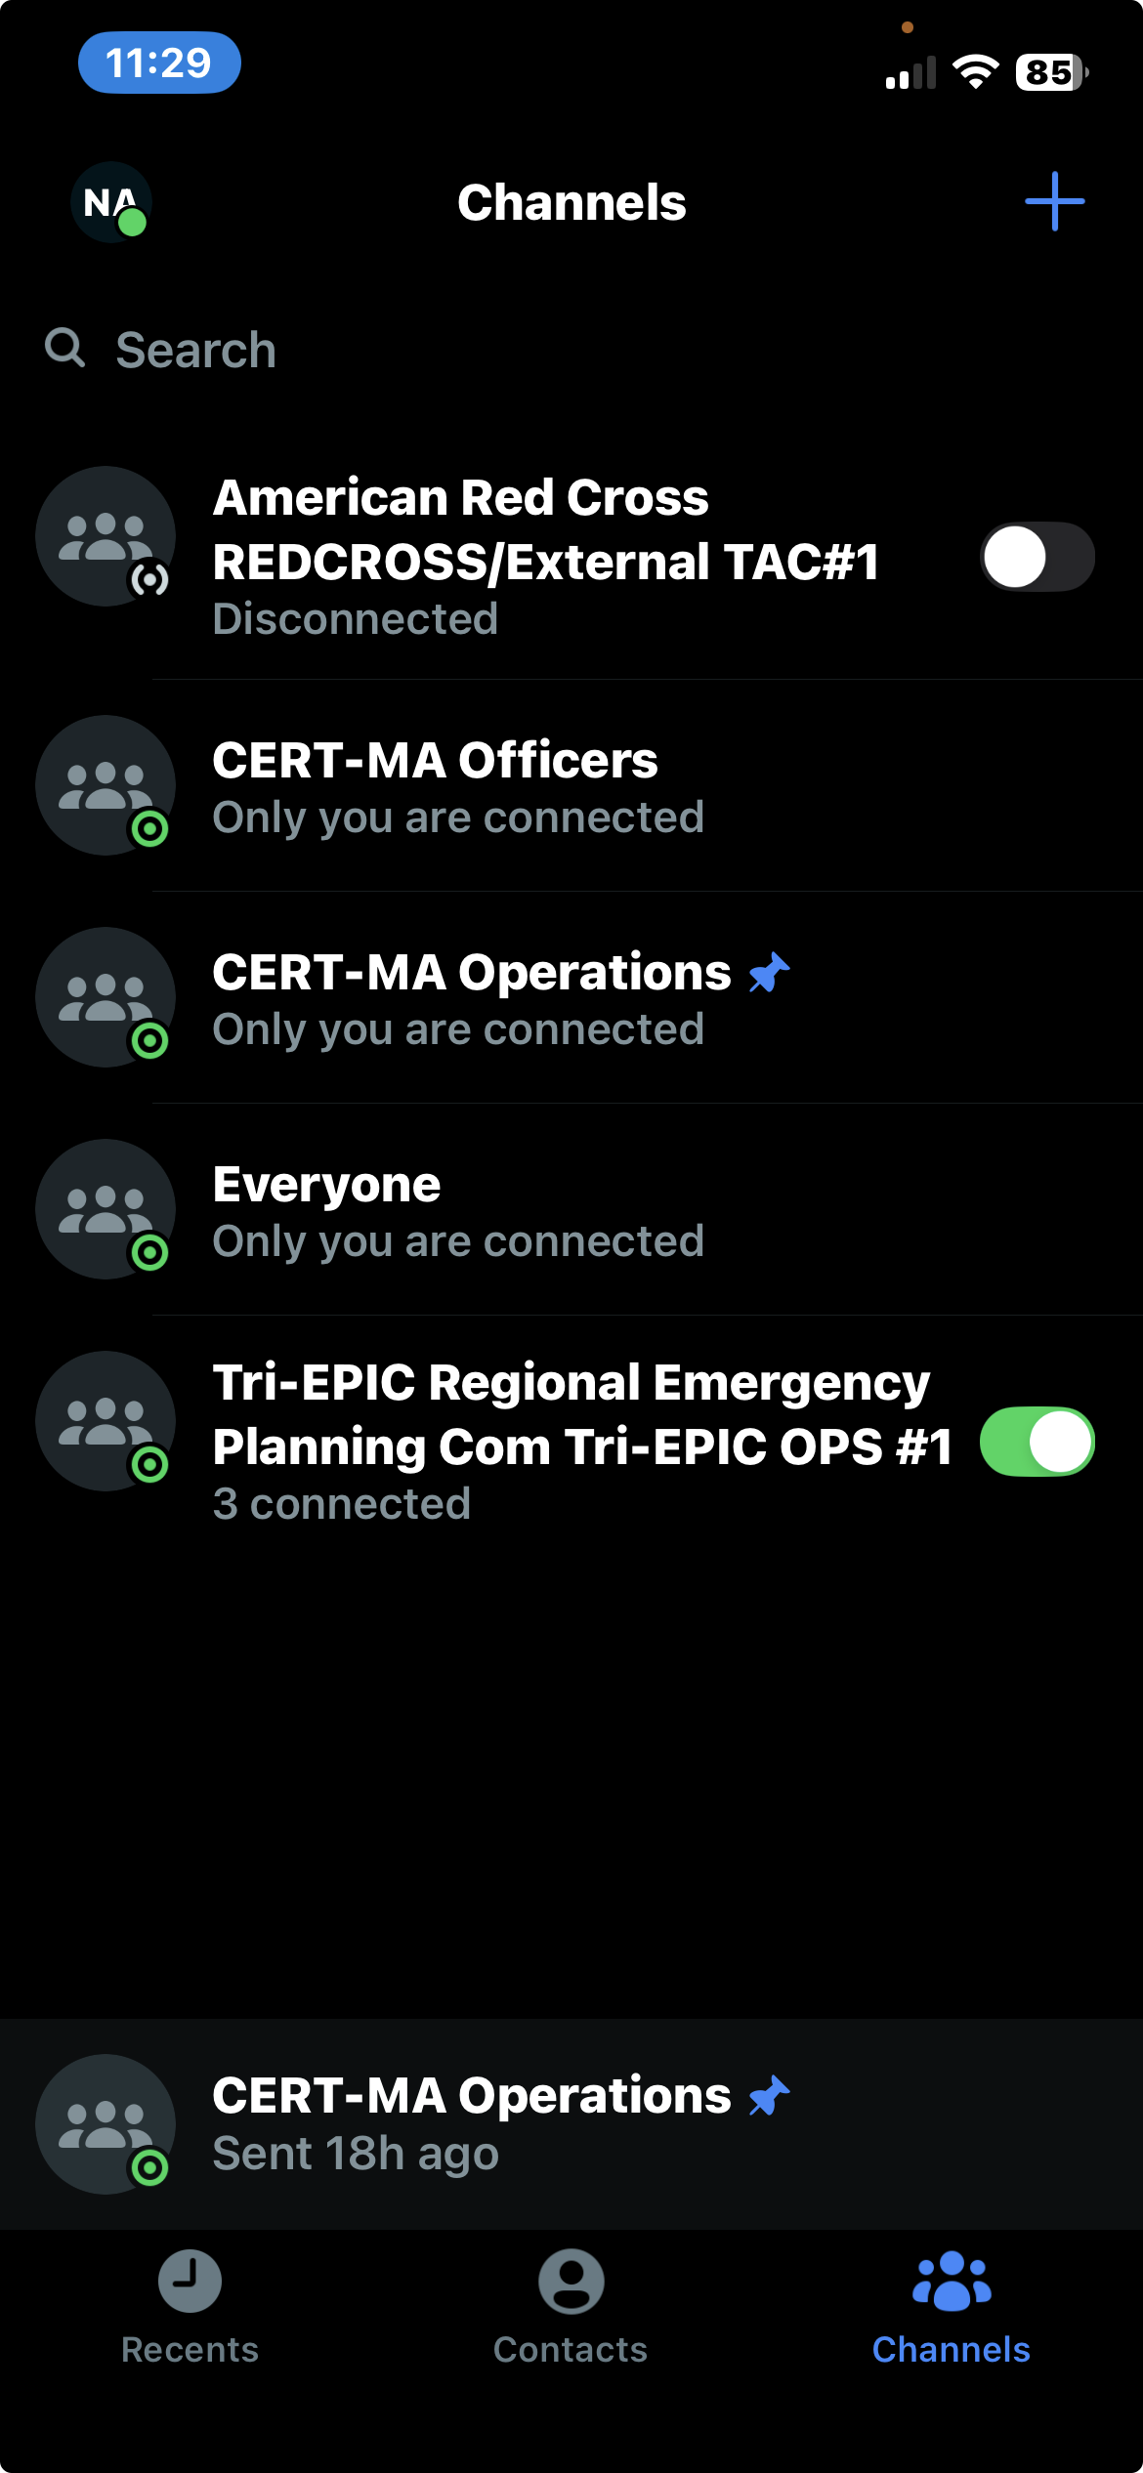
Channels Screen with Cross Links
Slider to turn Network
Off and on

Slide 21
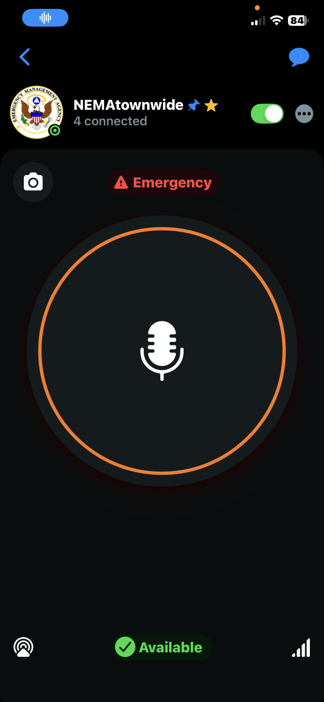
Phone on default Channel
Channel Name
And Avatar
Send a Picture
Replay last messages
Slider to turn off Channel
Menu to send location etc
Emergency button
Push to talk button
Connection quality
User Status

Slide 22
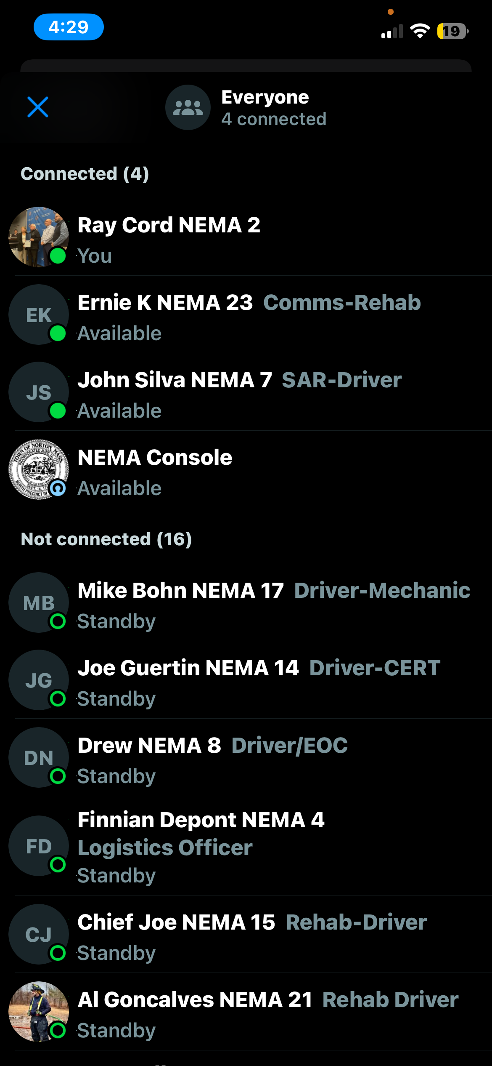
Contacts List on a single Channel
Channel users
Logged in
Note! You can add info to a contact
Such as unit # or position
Channel users not logged in

Slide 23
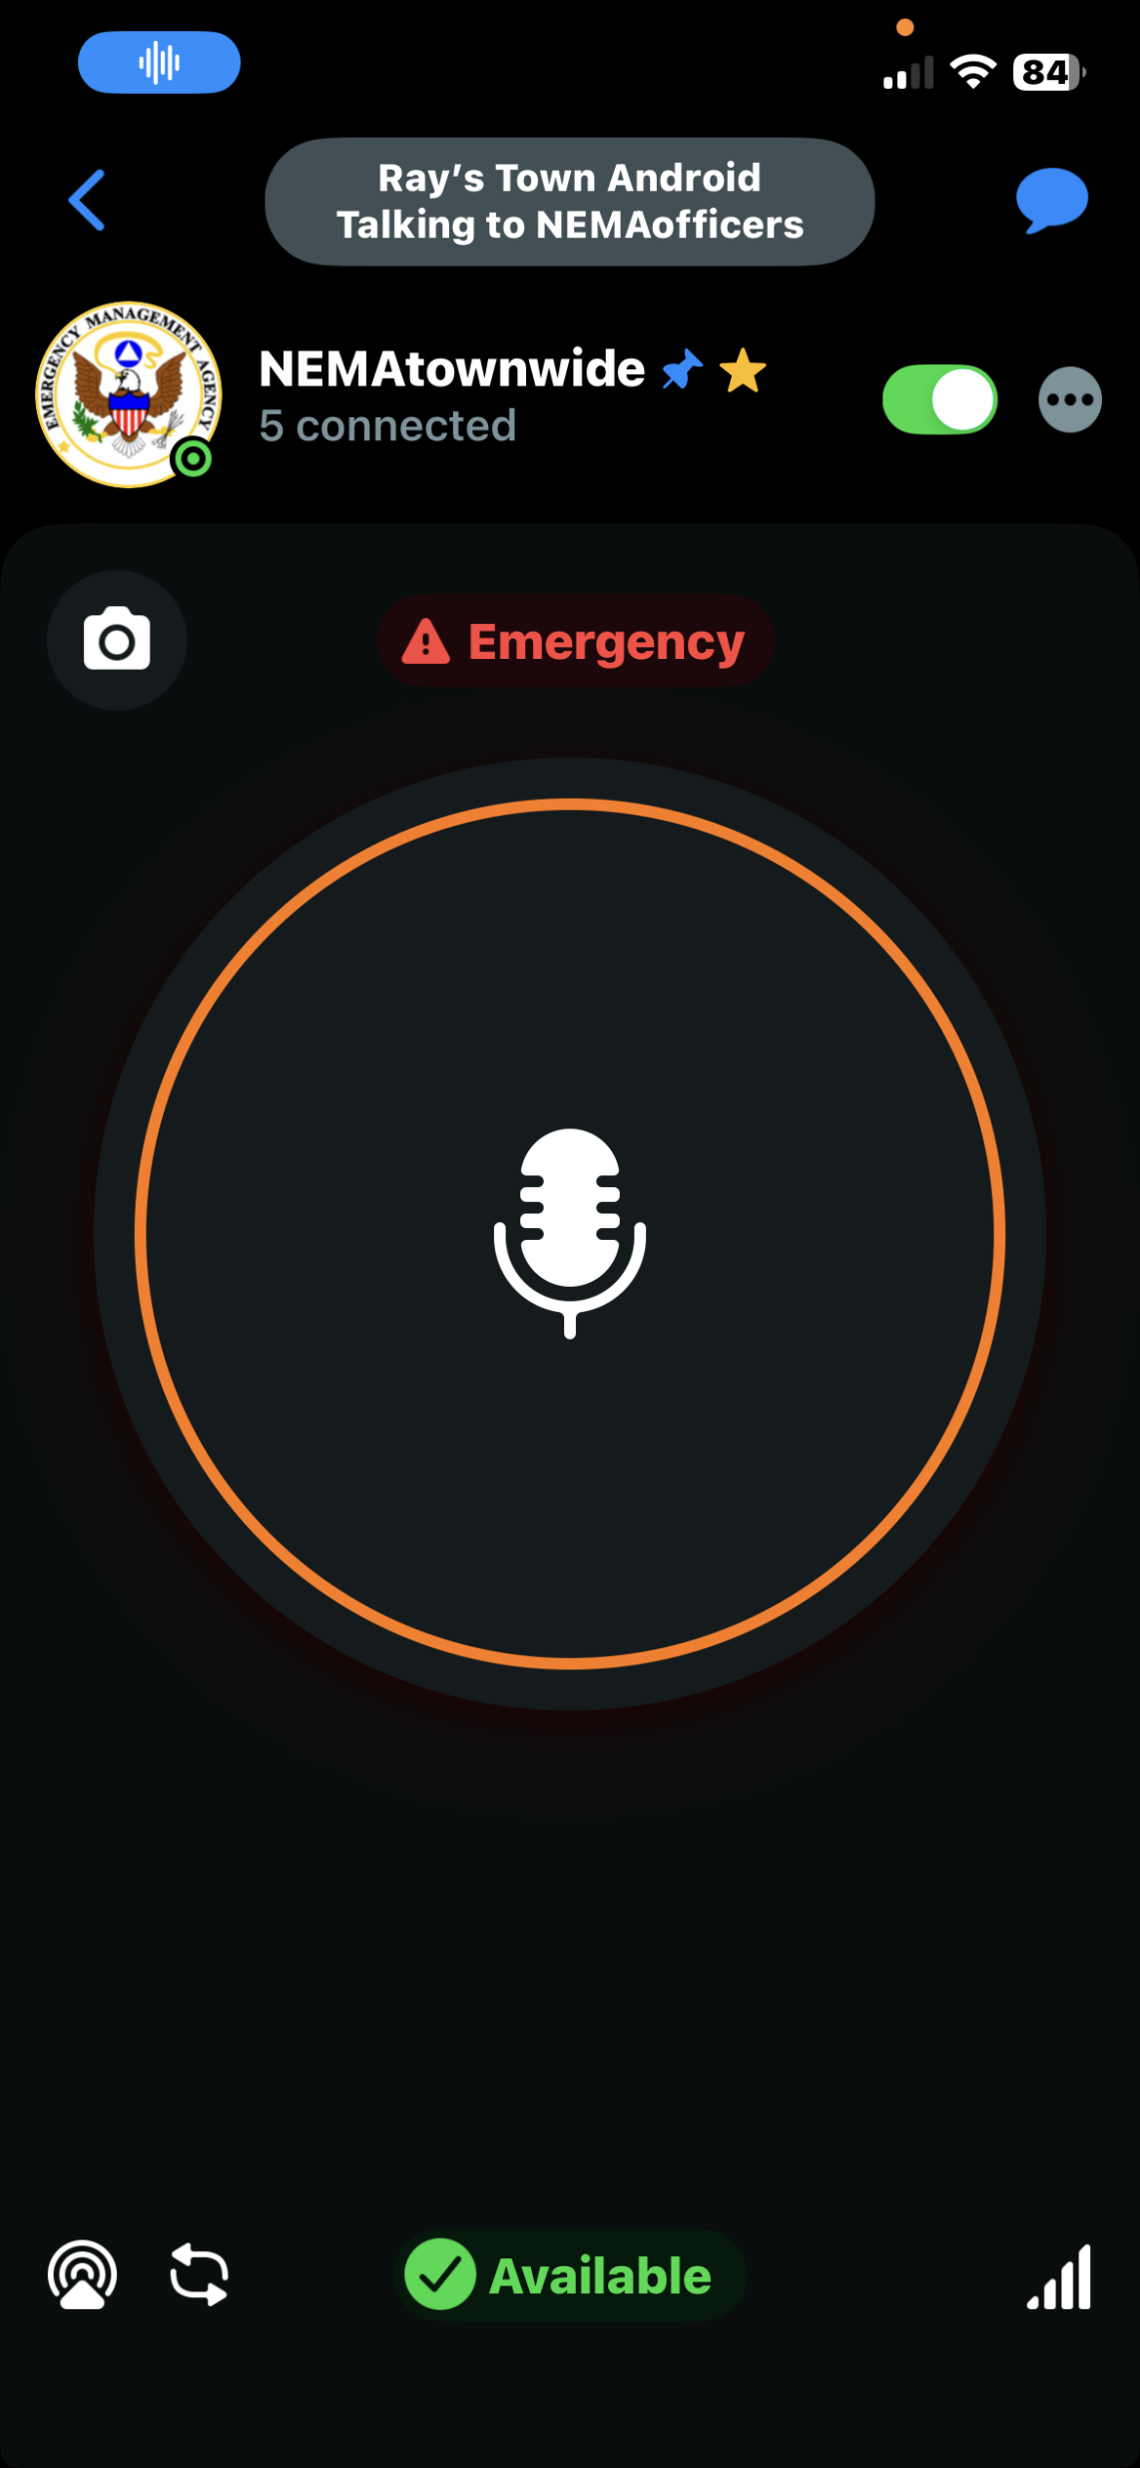
Indication of a call on another channel while you are on your default channel
Visual indication of
Who is calling and on what channel!
You also hear the audio from the transmission!

Slide 24
Conclusions
CERT Teams have to be able to communicate with their Public Safety Agencies
You shouldn’t have to carry multiple radios
We recommend those Towns that are on VHF stay on VHF and those on UHF stay there.
Use Zellowork as the bridge It can also provide Text Messaging & Alerting
If you are on UHF look at FRS/GMRS as a less expensive intra Team technology
If you are on VHF look at MURS as a less expensive intra Team Technology
Public Safety radios can be bought refurbished for under $200.00 P25 adds another $200.00
Get the software and cable to program your radios.
Communications tends to be a problem at every event because nobody understands it

Slide 25
So Now What?????
Each Team that wants to participate should apply for a ZelloWork network with First Responder Free Licenses. Appropriate # of users and 1 Gateway license for future use.
Set up your channels. Zello automatically creates one called “Everyone” You may want one for “Officers”, one for Operations and other for Administration. Include the name of you Team in the channel display name so we can ID you.
Set up your Team by inviting them to the network and to the channels.
After your network is up and running the Admin can go to Crosslink in the Administration tab of the console and request crosslinking to cert-ma@zellowork.com and who ever else yo wish to link to.
Practice and train!
Zello Tech Support is very helpful and their documentation is great
If you need help or have questions contact the Communications Committee

Slide 26
QUESTIONS??
Thank you to the Communications Committee
Eric Williams, Rob Millette, Steve Berien
Ray Cord Chair

